Slide 1

CO-1 Technical Presentation
A Case Study
CSA-0509 Database Management System
Presented By
Lokesh S (192511037)
Guided By
Dr .R .Kesavan

Slide 2


Introduction
ER (Entity Relationship) Model is a conceptual design tool used to represent entities, attributes, and relationships in a database.
Online Library Management System automates book management, member registration, issue/return processes, and fine calculation.
Entities such as Book, Member, Librarian, Loan, Author, and Publisher form the core components of the database.
Relationships define how entities interact, ensuring accurate data organization and efficient database operations.
ER diagrams provide a clear blueprint for database development, reducing redundancy and improving data consistency.

Slide 3
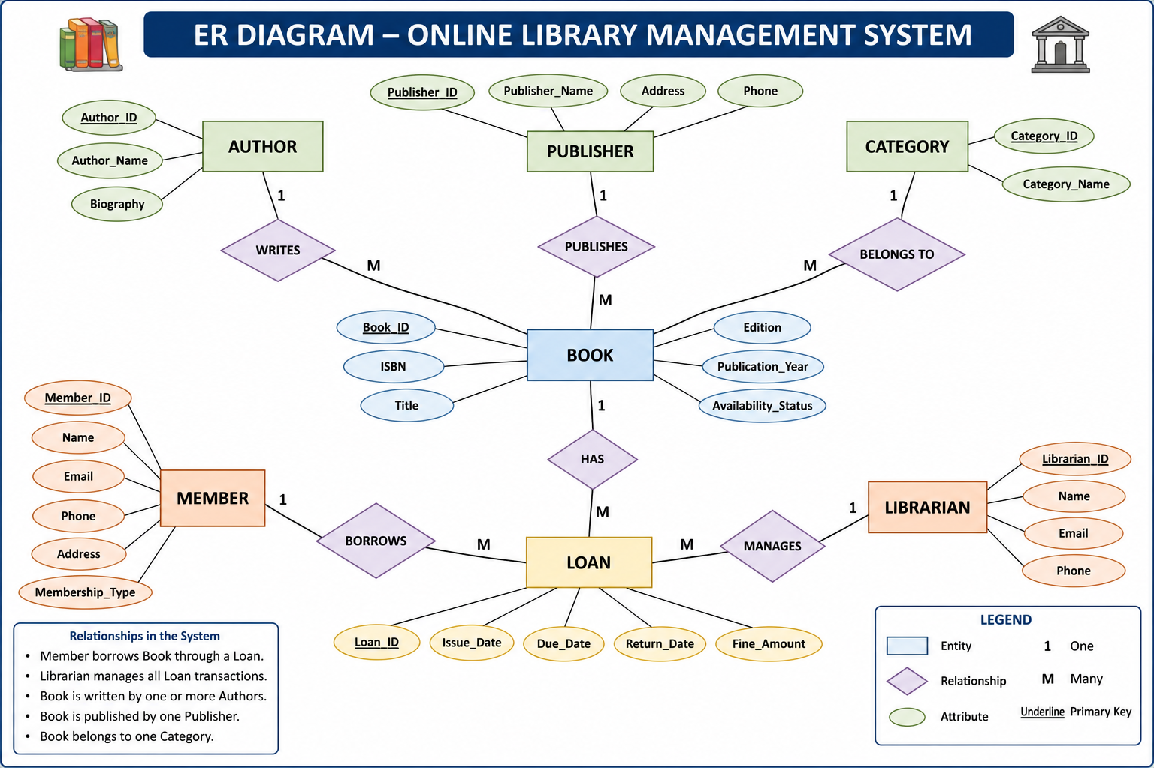
ER Diagram of an Online Library Management System

Slide 4
Explanation of the ER Diagram
Book is the primary entity that stores information such as Book ID, Title, ISBN, Edition, Publication Year, and Availability Status.
Member represents registered users who can borrow books. Each member has unique details like Member ID, Name, Email, Phone Number, and Address.
Loan acts as the linking entity between Members and Books, recording Issue Date, Due Date, Return Date, and Fine Amount for each borrowing transaction.
Author, Publisher, and Category are associated with books to organize library resources, making searching, classification, and management more efficient.
Relationships such as Member borrows Book, Author writes Book, Publisher publishes Book, and Book belongs to Category ensure data integrity and minimize redundancy in the database.

Slide 5
Introduction to Enhanced Entity Relationship
Enhanced Entity-Relationship (EER) Model is an extension of the ER model used to represent more complex database structures.
It introduces advanced concepts such as Generalization, Specialization, and Inheritance for better data modeling.
Generalization combines similar lower-level entities into a common higher-level entity (superclass).
Specialization divides a general entity into specialized sub-entities based on specific characteristics.
EER models are widely used in systems like universities, hospitals, banking, and enterprise applications to improve database flexibility and scalability.

Slide 6
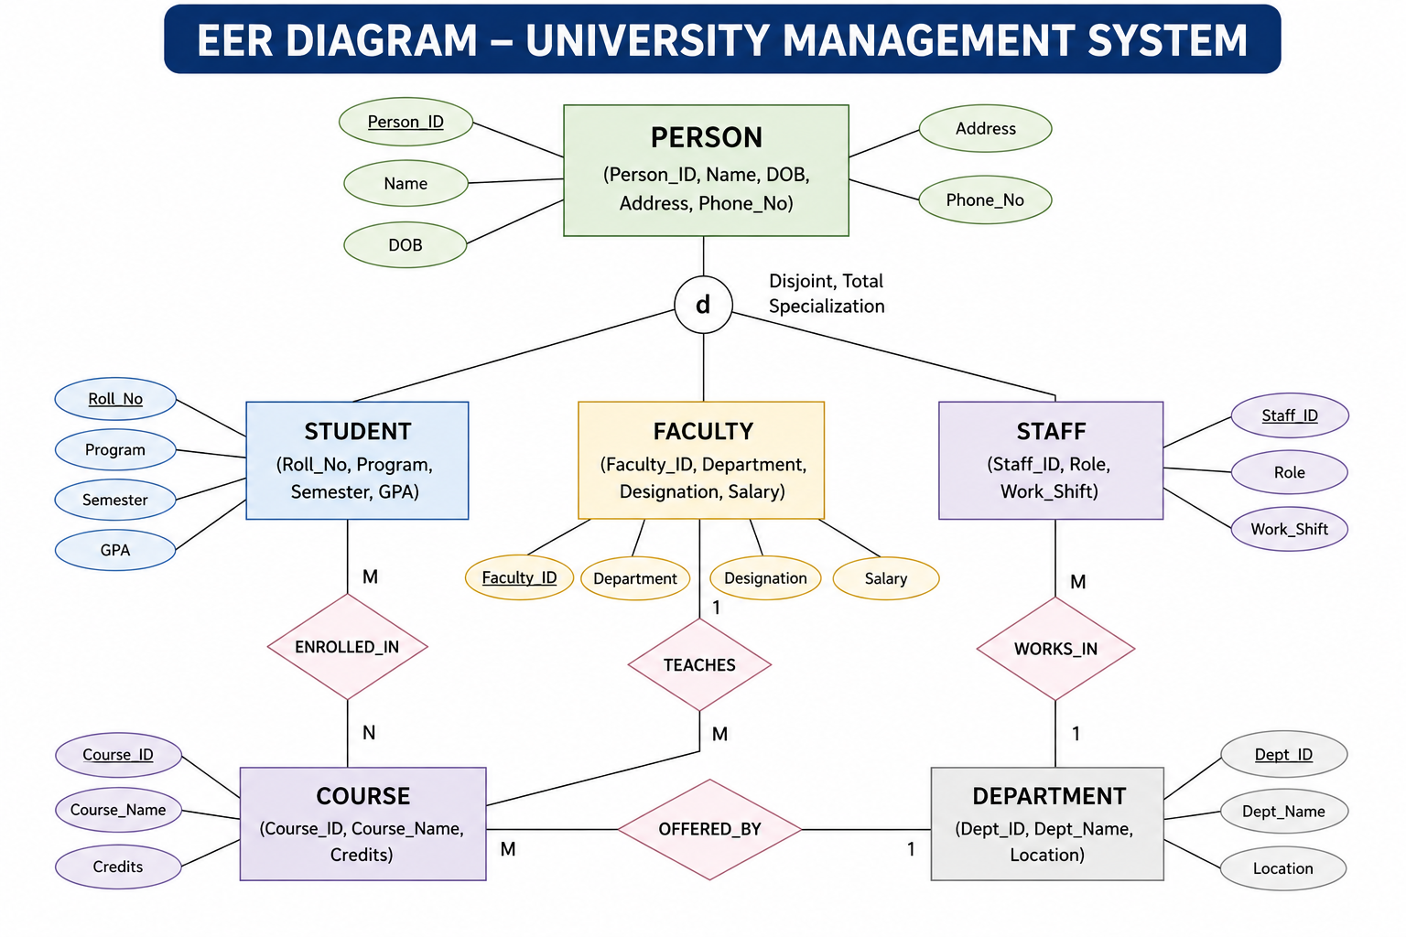
EER Model for University Management System

Slide 7
Explanation of the EER Model
Person is the superclass, containing common attributes shared by all individuals in the university.
Student, Faculty, and Staff are subclasses that inherit the common attributes of Person while maintaining their own specific attributes.
Course stores academic information, and Department manages courses, faculty, and staff within the university.
Relationships such as Enrolled_In, Teaches, Works_In, and Offered_By connect entities and represent real-world university operations.
The EER model reduces data redundancy, improves database organization, and provides flexibility for future system expansion.

Slide 8
Data Independence in DBMS
Data Independence is the ability to modify the database schema without affecting application programs or user access.
Logical Data Independence allows changes to the conceptual schema without affecting external user views.
Physical Data Independence allows changes to the internal storage structure without affecting the conceptual schema.
Data independence is achieved through the Three-Schema Architecture consisting of External, Conceptual, and Internal levels.
It improves database flexibility, maintainability, scalability, and performance while reducing application maintenance.

Slide 9
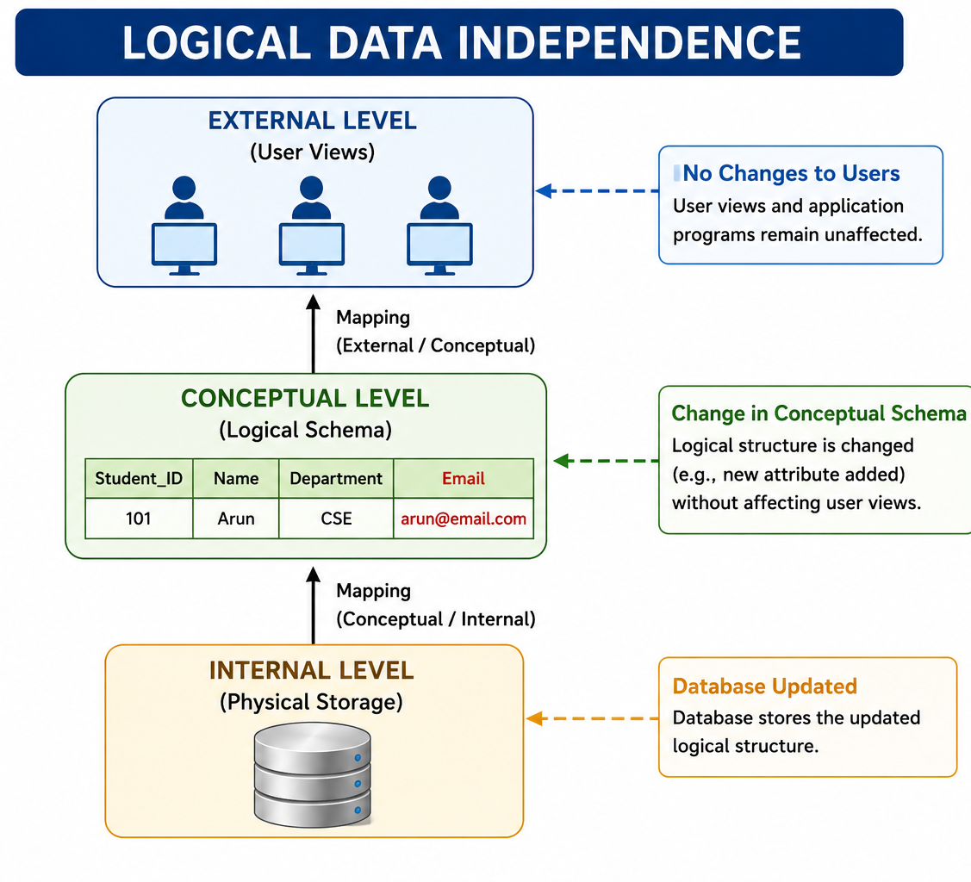
Logical Data Independence
Logical Data Independence is the ability to modify the conceptual schema without affecting external user views or application programs.
It allows changes such as adding, deleting, or modifying attributes, entities, and relationships while maintaining application functionality.
It provides flexibility to adapt the database structure to changing business requirements.
Logical Data Independence is more difficult to achieve because application programs are closely related to the logical structure.
Example: Adding an Email attribute to the Student table without changing existing user applications.

Slide 10
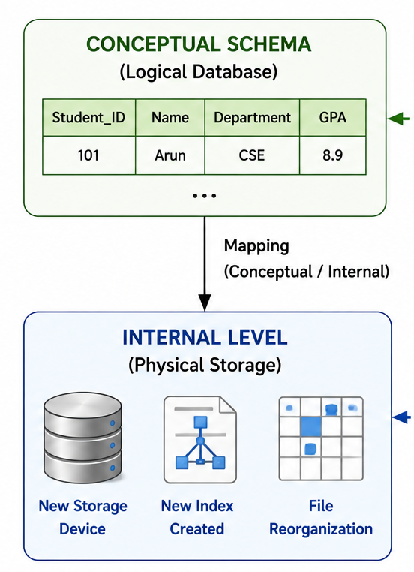
Physical Data Independence
Physical Data Independence is the ability to modify the internal storage structure without affecting the conceptual schema or application programs.
It allows changes in file organization, storage devices, indexing techniques, and access methods without altering the logical database design.
Physical Data Independence improves database performance, storage efficiency, and system scalability.
It is easier to achieve than Logical Data Independence because application programs do not depend on physical storage details.
Example: Creating an index on the Student table or moving data to a faster storage device without changing the database schema.

Slide 11
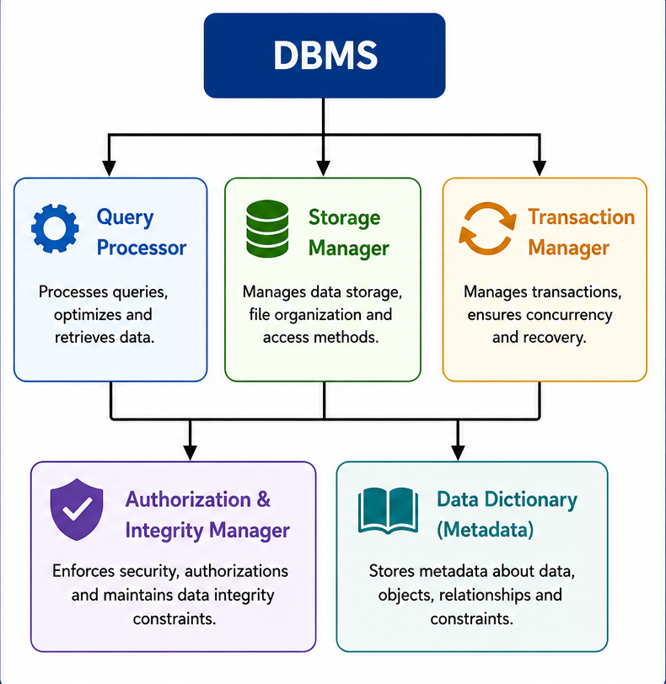
Introduction to DBMS Software Components
DBMS Software Components are the internal modules that work together to manage, store, retrieve, and secure data efficiently.
They provide an interface between users, applications, and the database, ensuring smooth data processing.
Each component performs a specific function such as query processing, storage management, transaction handling, and security.
These components work together to ensure data consistency, integrity, reliability, and efficient performance.
The major DBMS software components include Query Processor, Storage Manager, Transaction Manager, Authorization & Integrity Manager, and Data Dictionary.

Slide 12
Functions of DBMS Software Components
Query Processor – Interprets SQL queries, optimizes execution plans, and retrieves the required data efficiently.
Storage Manager – Manages data files, indexes, buffer memory, and physical storage of the database.
Transaction Manager – Ensures ACID properties, concurrency control, and recovery from system failures.
Authorization & Integrity Manager – Controls user access, enforces security policies, and maintains data integrity constraints.
Data Dictionary (Metadata) – Stores information about database objects, tables, attributes, relationships, indexes, and user permissions.

Slide 13
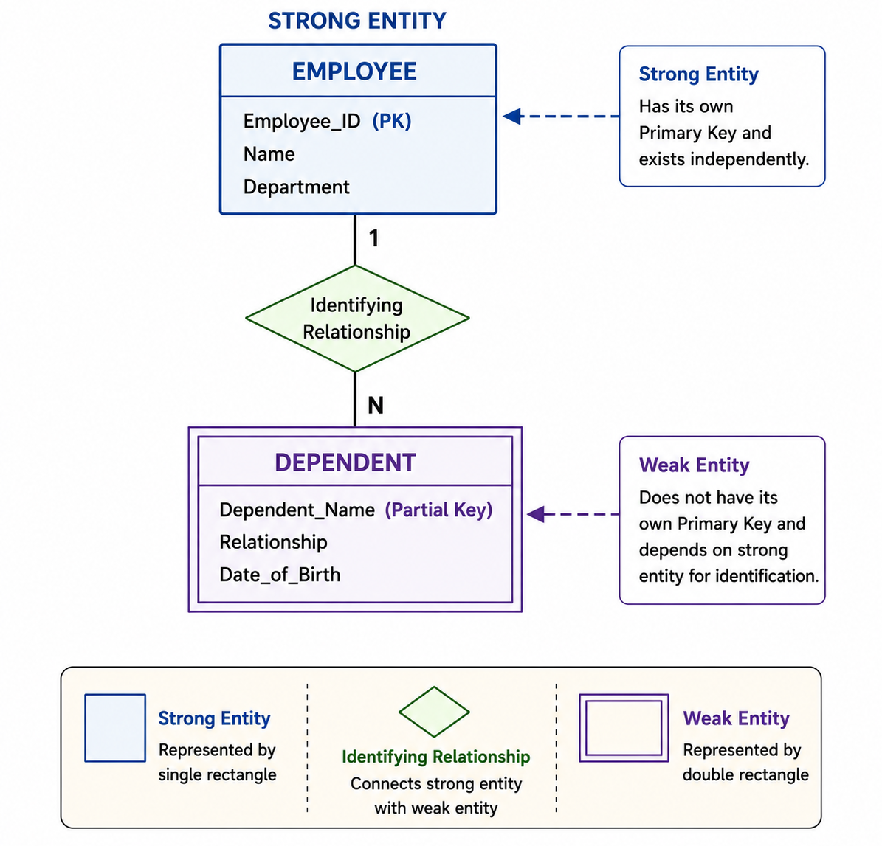
Strong Entity vs Weak Entity
An Entity represents a real-world object, person, place, or concept stored in a database.
A Strong Entity has its own Primary Key and can exist independently.
A Weak Entity does not have a Primary Key of its own and depends on a strong entity for identification.
A weak entity is identified using a Partial Key along with the Primary Key of its owner (strong entity).
Strong and weak entities help model real-world relationships accurately and improve database design.

Slide 14
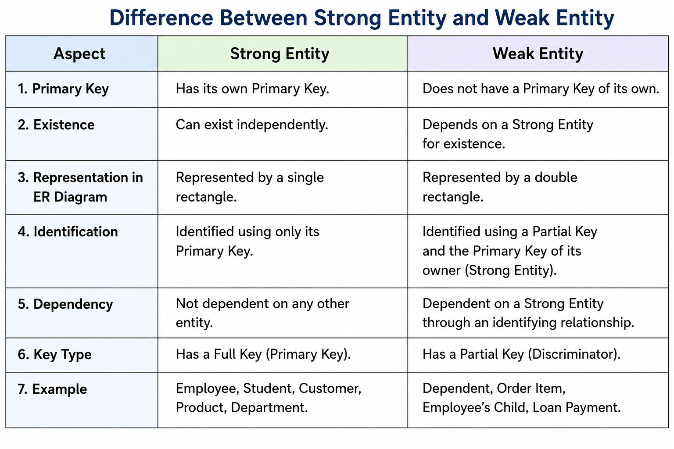
Comparison of Strong Entity and Weak Entity

Slide 15
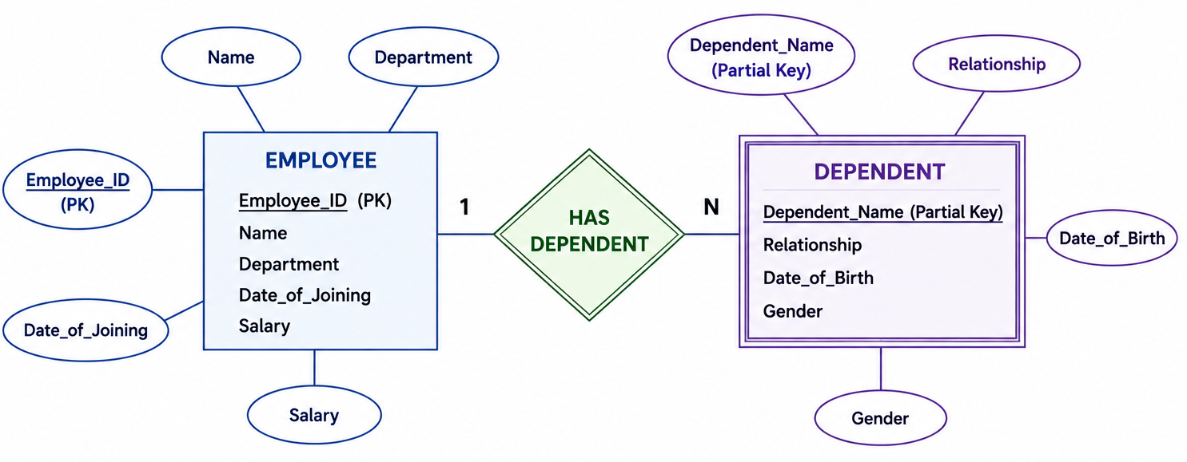
ER Diagram for the Strong vs Weak Entity

Slide 16


